Slide 1

Post-Treatment Brain Tumor Segmentation of High- and Low-Grade Gliomas
Using U-Net on the BraTS 2024 Dataset
Presented by: Muhammad Wahaj Sajid & Basit Ali
Supervised by: Ms. Mutyyba Asghar
Department of CS & IT

Slide 2
Introduction
The Critical Role of Post-Treatment Segmentation

Slide 3
The Challenge of Post-Treatment Analysis
Foundation for Neuro-Oncology: Critical for evaluating treatment response and monitoring tumor progression.
Informed Decisions: Enhances clinicians' ability to assess disease status and make therapeutic decisions.
Post-Treatment Complexity: Scans capture complex tumor morphology after surgery, radiation, and chemotherapy.
Clinical Need: Essential for predicting survival, assessing residual tumor burden, and identifying early signs of recurrence.

Slide 4


Focus: High-Grade vs. Low-Grade Gliomas
High-Grade Gliomas (HGG)
Low-Grade Gliomas (LGG)
Known for their aggressive nature and high recurrence rates, even after surgical resection. Accurate post-treatment analysis is vital.
Typically exhibit slower growth but carry a significant risk of progressing to higher grades over time. Monitoring is key.
Differentiation between these subtypes is crucial due to their distinct biological behaviors and treatment paths.

Slide 5
Methodology
Our Deep Learning Approach

Slide 6
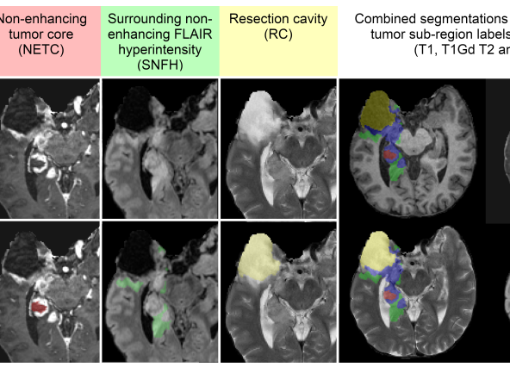

The BraTS 2024 Dataset
Our research is built upon this foundational dataset:
•
A large-scale, standardized, and expertly annotated collection.
•
Specifically focuses on complex post-treatment MRI scans.
•
Enables the development of robust and generalizable models.
•
Includes multimodal MRI sequences: T1, T1ce, T2, and FLAIR.

Slide 7








Target: Tumor Subregions for Delineation
Enhancing Tissue (ET)
Non-Enhancing Tumor Core (NETC)
Represents the active, contrast-enhancing part of the tumor.
Includes the necrotic or cystic core of the tumor.
Surrounding Non-Enhancing FLAIR Hyperintensity (SNFH)
Resection Cavity (RC)
The area corresponding to the surgically removed tissue.
Represents peritumoral edema or non-enhancing infiltration.

Slide 8
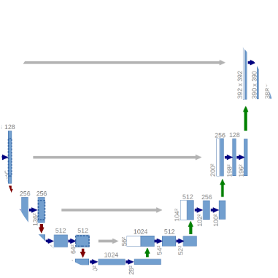

Our Model: The U-Net Architecture
Why U-Net?
We employ the U-Net architecture, a powerful encoder-decoder structure, for this task.
•
Effectively captures fine-grained spatial features.
•
Retains global contextual information.
•
Proven to be highly effective for biomedical image segmentation.

Slide 9
Evaluation Metrics
DSC
Measuring Success
Performance will be rigorously trained and validated on the BraTS 2024 dataset.
Dice Similarity Coefficient
We will use established metrics to measure accuracy, primarily the Dice Score (DSC), along with sensitivity and specificity.

Slide 10
Aims & Expected Impact
From Research to Clinical Practice

Slide 11
Goals of This Research
Contribute: Develop a reliable and efficient segmentation framework.
Enhance: Improve the accuracy of post-treatment glioma analysis.
Support: Aid clinical decision-making and improve prognosis estimation.
Advance: Promote the integration of automated image analysis tools into clinical practice.
Foster: Enable personalized treatment planning and better patient outcomes.

Slide 12


Advancing Neuro-Oncology
A reliable, automated framework for personalized patient care.

Slide 13
Questions?
Thank you for your attention.

